Slide 1
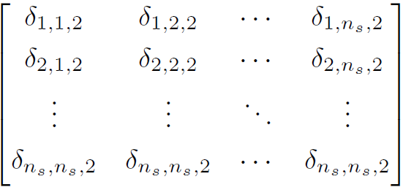
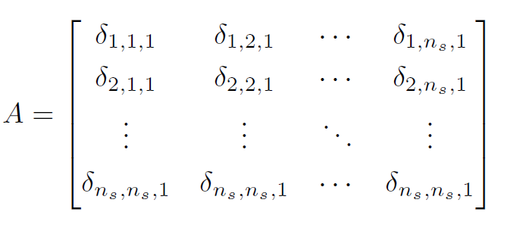
Transition Array first 2 layers

Slide 2
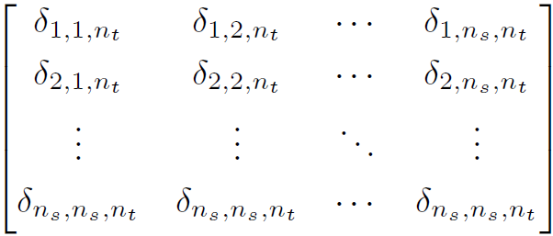
Transition Array
Notes:
The tekst of the last part is a little smaller - due to the fact that the matrix is

Slide 3
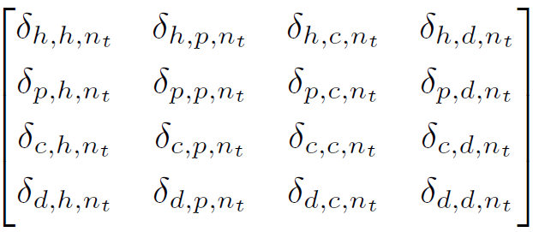
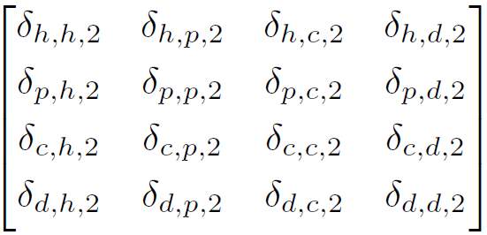
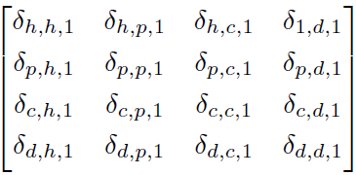
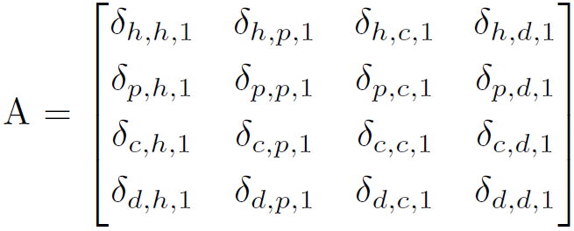



Transition Array - cancer
$$n_{t}$$
$$n_{s}$$
$$n_{s}$$
Notes:
The tekst of the last part is a little smaller - due to the fact that the matrix is 225%

Slide 4
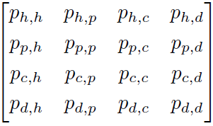
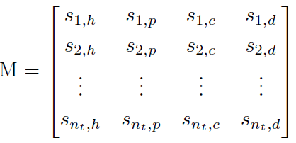


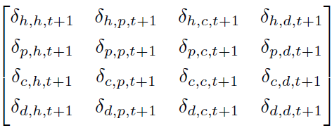
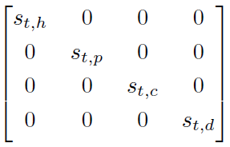
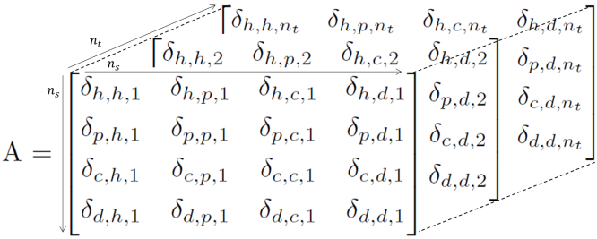







Final result
(1) Traditional Approach
Matrix M$(n_{t}×n_{s})$
$$M_{t+1} { M}_{t} P$$
$$=$$
$$n_{s}$$
$$n_{t}$$
$$=$$
The health states of the simple cancer state transition model are states h=healthy, p=polyp, c=cancer, and d=dead
: proportion of the cohort at risk for cancer at t=1
(2) Complementary Approach
Matrix A$(n_{s}×n_{s}×n_{t})$
$$A_{t+1} = {diag(M}_{t}) P$$
$$=$$
: proportion of the cohort at risk transfering to cancer at t=1
Figure 1: (1) The Conventional Approach computes a Markov trace M, describing the distribution of the cohort or individuals among the different health states over time (2) The Complementary Approach computes the matrix A containing all information regarding the transition dynamics of the cohort or individuals over time.
Notes:
150% of PDF to take snap shots

Slide 5
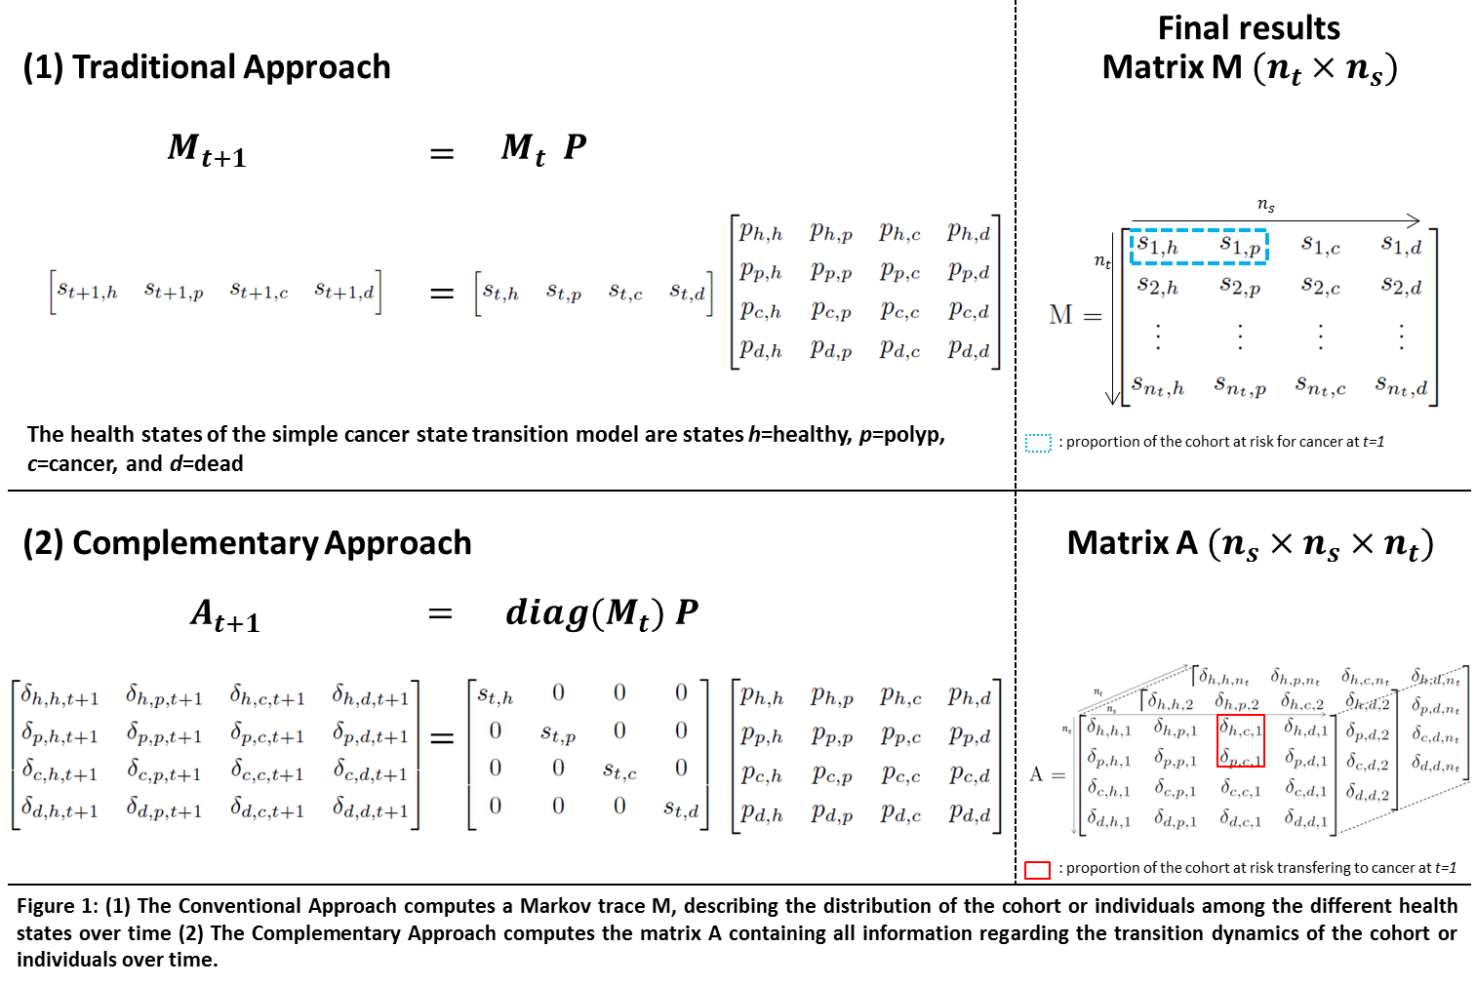

Slide 7



Transition Probabily Array – Sick-sicker
$$n_{t}$$
$$n_{s}$$
$$n_{s}$$
Notes:
The tekst of the last part is a little smaller - due to the fact that the matrix is 225%
P_(t)[H, H]
S_1 not a subscribt = S1
3D- arrray with tunnels →
P(1)_HH
S(1)_1…

Slide 9



$$n_{t}$$
$$n_{s}$$
$$n_{s}$$

Slide 11



$$n_{t}$$
$$n_{s}$$
$$n_{s}$$

